Slide 1

Northeastern University - Seattle
CS6650 Building Scalable Distributed Systems
Vishal Rajpal

Slide 2
Week 10 – Strong Consistency and Distributed Databases
Topics we will cover today:
What is Eventual Consistency
Read Your Own Writes
Tunable Consistency
Quorums
Replica Repair
Merkle Tree
Handling Conflicts
Logical Clocks
Conflict Free Replicated Data Types (CRDTs)

Slide 3
What is Eventual Consistency
Single copy of data object = always consistent
Multiple copies of data object
How long do updates take to propagate?
What if a node fails?
What if there’s a network partition?
Eventual consistency
What guarantees does a database give a client?
How long until all replicas consistent?

Slide 4
Inconsistency Window
Duration depends on
The number of replicas
Operational environment
Distance between replicas
Implication: No upper bound
Notes:
The inconsistency window in an eventually consistent system is the duration it takes for an update to a data object to propagate to all replicas. The inconsistency window ends when all replicas have the same value.
All these issues mean that you don’t have control over the duration of the inconsistency window. You can’t provide or know an upper bound. With eventually consistent systems that communicate state changes asynchronously, this is a fact of life you have to live with.

Slide 5
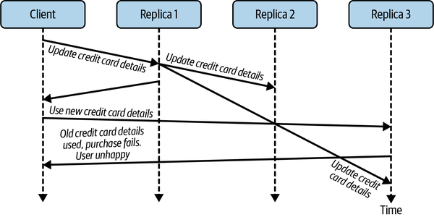
Read Your Own Writes
if a client makes a persistent change to data, the updated data value is guaranteed to be returned by any subsequent reads from the same client.

Slide 6
Read Your Own Writes
Client sees its own writes
Other clients will see the writes ‘eventually’
Supported by many NoSQL databases
Leader follower – just read from leader!
Notes:
To avoid this situation, a system needs to provide RYOWs consistency. This guarantees, for an individual user, that any updates made by the user will be visible in subsequent reads. The guarantee doesn’t hold for other users. If I add a comment to an online article, when I reload the page, I will see my comment. Other users who load the page at the same time may or may not see my comments immediately. They will see it eventually.
With leader-follower replication, implementing read your writes consistency is straightforward. For use cases that require RYOWs, you simply ensure the subsequent read is handled by the leader replica. This is guaranteed to hold the latest data object value.

Slide 7
Tunable Consistency
Enables you to tailor the database’s eventually consistent behavior.
Trade off performance of read and write operations based on the level of eventual replica consistency a use case can tolerate.
Based on 3 parameters:
N: Total number of replicas
W: Number of replicas to update before confirming the update to the client
R: Number or replicas to read from before returning a value

Slide 8

Tunable Consistency
Assume leaderless database
Example:
N=3
W= 3
R = 1
Often called immediate consistency
Clients can still see different replica values
Updates in progress
‘concurrent writes’
Notes:
As an example, assume N = 3, and there is a leaderless database in which any individual request can be handled by any one of the replicas. The replica handling the request is called the coordinator. You can tune write operation performance and the extent of the inconsistency window by specifying the W value as shown in the following examples:
W = 3 :The request coordinator will wait until all three replicas are updated before returning success to the client.
W = 1 :The request coordinator will confirm the update locally and return success to the client. The other two replicas will be updated asynchronously.
This means if W = 3, all replicas will be consistent after the write completes. This is sometimes called immediate consistency. In this case, clients can issue reads with a value of R = 1 and they should receive the latest value, as long as reads are not concurrent with the replica updates.
Reads that occur while the replicas are being updated may still see different values depending on the replicas they access. Only once the replica values have converged will all reads see the same value. Hence immediate consistency is not the same as strong consistency (see Chapter 12) as stale reads are still possible.4

Slide 9
Tunable Consistency
What if:
R=N and W=1
Slow reads, fast writes
Write availability
Latest replica value returned
W=N, R=1
Fast reads, slow writes
Immediate consistency

Slide 10
CAP Theorem Revisited
W=N:
Consistent replicas
Slower writes
Writes fail if W replicas not available
CP
W=1:
Writes succeed with 1 available replica
Inconsistency window
AP

Slide 11
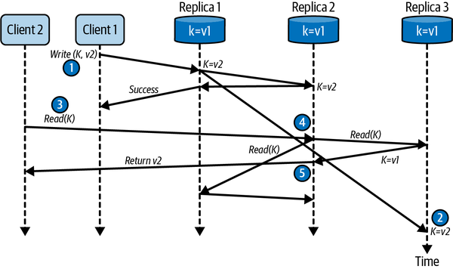
Quorums
Quorum = majority
(N/2)+1
Configure W and R to be quorum to balance read and write performance
Example: W=R=2
Notes:
There’s an option that lies between the alternatives discussed in the previous section. These are known as quorum reads and writes. Quorum simply means the majority, which is (N / 2) + 1.5 For our three replicas, the majority is two. For five replicas, the majority is three, and so on.
If we configure both the W and R value to be the quorum, we can balance the performance of reads and writes and still provide access to the latest updated value of a data object
With three replicas, a quorum means a write must succeed at two replicas, and a read must access two replicas. Initially all three replicas have a data object K with value v1, and the following sequence of actions takes place:
Example
Client 1 updates the object to hold value v2 and the write is acknowledged as successful once a quorum—in this case Replica 1 and Replica 2—are updated.
The command to update to Replica 3 is delayed (slow network? busy node?).
Client 2 issues a read on object K.
Replica 2 acts as the request coordinator and sends a read request to the other two replicas for their value for K. Replica 3 is first to respond with K = v1.
Replica 2 compares its value for K with that returned from Replica 3 and determines that v2 is the most recently updated value. It returns value v2 to Client 2.

Slide 12
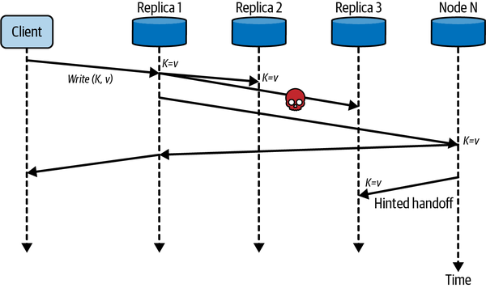
Quorums
Works because overlap of W and R majorities
Downsides
Read/writes fail if majority not available
Not tolerant to network partitions
Sloppy Quorum
Address availability problem
If write quorum not achievable:
Write to another reachable node N
When home node for replica available, update value from N
Notes:
In some database systems designed to favor availability over consistency, the concept of a sloppy quorum is supported. Sloppy quorums were first described in Amazon’s original Dynamo paper,6 and are implemented in several databases including DynamoDB, Cassandra, Riak, and Voldemort.
The idea is simple. If a given write cannot achieve quorum due to the unavailability of replicas nodes, the update can be stored temporarily on another reachable node. When the home node(s) for the replica(s) become available again, the node storing the update performs what is called a hinted handoff. A hinted handoff sends the latest value of the replica to the home nodes from its temporary location.

Slide 13
Replica Repair
Large scale operational databases have replica drift
Network failures
Node stalls
Disk crashes
Bugs
Replicas tend to entropy (disorder)
We need Anti-entropy repair!!!
Active repair
Fixes consistency problems on access
Passive repair
Background periodic task
Notes:
In a distributed, replicated database, you expect every replica will be consistent. Replication may take a while, but consistency is always the ultimate outcome. Unfortunately, in operational databases, replica drift occurs. Network failures, node stalls, disk crashes, or (heaven forbid!) a bug in the database code can cause replicas to become inconsistent over time.
A term from thermodynamics, entropy, is used to describe this situation. Basically, systems tend to entropy (disorder) over time. Because of entropy, databases need to take active measures to ensure replicas remain consistent. These measures are known collectively as anti-entropy repair.

Slide 14
Replica Repair
Active Repair
Aka read repair
Occurs on data object access
Request coordinator reads all replicas
Sends latest value to any stale replicas
Many ways to implement
Digest reads/Hashes of objects exchanged
More efficient when objects large

Slide 15
Replica Repair
Passive Repair
Most data objects are rarely accessed
Passive repair accesses all objects
Periodic background task
Build a compressed representation of large object collections
Compares compressed representation to check for differences
Notes:
Passive anti-entropy repair is a process that typically runs periodically and is targeted at fixing replicas that are infrequently accessed. Essentially, the approach builds a hash value that represents each replicated collection of objects and compares the hashes of each collection. If the hashes match, no repair is needed. If they don’t, you know some replicas in the collection are inconsistent and further action is needed.

Slide 16
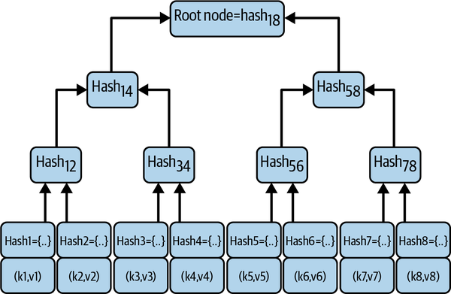
Merkle Tree
Notes:
To create an efficient hash representation of a potentially very large collection of data objects, a data structure called a Merkle tree7 is typically utilized. A Merkle tree is a binary hash tree whose leaf nodes are hashes of individual data objects. Each parent node in the tree stores a hash of its pair of children nodes, such that the root node hash provides a compact representation of the entire data collection. Figure 11-4 shows a representation of a simple Merkle tree.
Once a Merkle tree for a collection of objects has been constructed, it can be efficiently utilized to compare Merkle trees for each replica collection. Two nodes can exchange the root node hash, and if the root node values are equal, then the objects stored in the partitions are consistent. If they are not, the two child nodes of the root must be compared. One (or maybe both) of the child node hashes must be different as the root node hashes were different. The traversal and data exchange algorithm basically continues down the tree, following branches where hashes are not equal between replica trees, until leaf nodes are identified. Once identified, the stale data objects can be updated on the appropriate replica node.

Slide 17
Handling Conflicts
How is latest version of an object determined?
Different replicas
Different values
Which is most current?
Leaderless system
Any replica can coordinate updates
Concurrent updates to different replicas
What order should they be applied?
What is final value?

Slide 18
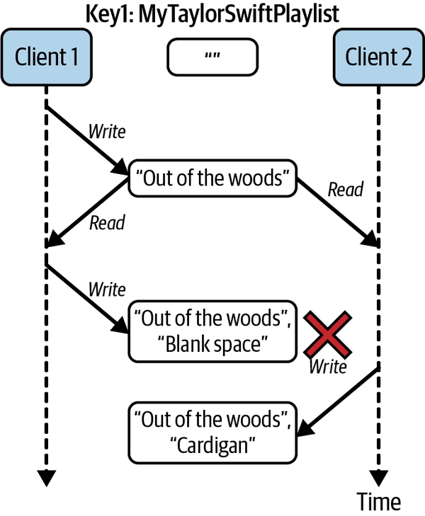
Handling Conflicts
Last Writer Wins
Use timestamps on updates
Update with most recent timestamp wins
Simple & Fast
What about clock drift?
Comparing timestamps across machines is not useful
Updates execute on different nodes concurrently
Timestamps impose arbitrary order on updates for conflict resolution purposes
Lost Updates
Notes:
The consequence of this is when concurrent updates occur using last writer wins, updates will be silently discarded. Figure 11-5 depicts one scenario where updates are lost using a shared playlist as an example. Client 1 writes the first entry to the playlist, and this entry is subsequently read at some time later by both Client 1 and Client 2. Both clients then write a new entry to the playlist, but as Client 2’s update is timestamped later than Client 1’s, the updates made by Client 1 are lost.

Slide 19
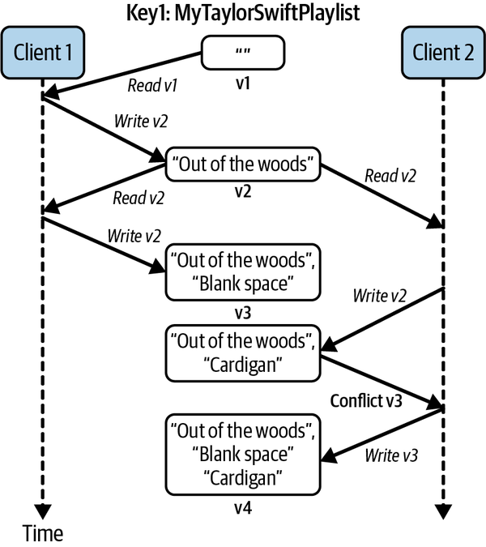
Handling Conflicts
Last Writer Wins
Data loss inevitable
Mitigations might help:
Timestamps on individual object fields
Conditional writes
Only way to not lose data:
Writes create new key/object
Objects considered immutable
Changes create a new immutable object
Version Vectors
Notes:
To handle concurrent updates and not lose data, we need a way to identify and resolve conflicts. Each unique database object is stored along with a version number.
Reading and writing data from the database proceeds as follows:
When a client reads a database object, the object and its version are returned.
When a client updates a database object, it writes the new data values and the version of the object that was received from the previous read.
The database checks that the version in the write request is the same as the object’s version in the database, and if it is, it accepts the write and increments the version number.
If the version number accompanying a write does not match the database object version, a conflict has occurred, and the database must take remedial action to ensure data is not lost.
It may return an error to the client and make it reread the new version. Alternatively, it may store both updates and inform the client that a conflict has occurred.

Slide 20
Handling Conflicts
Implemented in Riak and other databases
Database manages versioning
Conflict detection returns siblings
Client resolves conflict
With multiple replicas
Version per replica
Version vector has entry for each replica
Replicas exchange version vectors and detect conflicts
Based on logical/vector clocks
Notes:
With multiple replicas, however, the situation is somewhat more complex.
As writes may be handled by any replica, we need to maintain the version number for each unique object and each replica.
Replicas maintain their own version as writes are processed, and also keep track of the versions of the other replicas it has seen. This creates what is known as a version vector.
When a replica accepts a write from a client, it updates its own version number and sends the update request along with its version vector to the other replicas.
The version vector is used by a replica to decide whether the update should be accepted or if siblings should be created.
The management of version vectors is the responsibility of the database. Database clients just need to present the latest version with updates and be able to handle conflicts when they occur

Slide 21
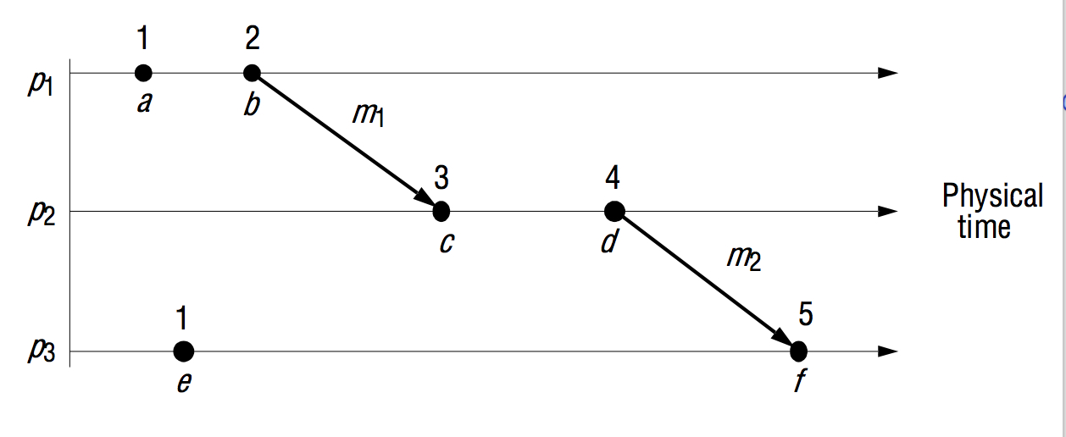
Logical Clocks
Technique to establish the (partial) order of events in distributed systems
Lamport Clocks
Algorithm to provide a partial ordering of events in a distributed system
Every process maintains a local logical clock, initialized to zero
Event occurs:
# increment local clock
local_clock ++;
# send message to another process
send(msg, local_clock);
When the receiving process accepts the message, it sets its own local clock as follows:
(msg, clock_msg) = receive();
local_clock = max(clock_msg, local_clock) + 1;
Notes:
What about e?

Slide 22
Logical Clocks
Identify a happened-before ordering that is described numerically
if C(a)<C(b), C(a) happened-before C(b).
Partial causal ordering
Only meaningful in terms of messages flowing between a group of processes
If a and b are two events in the same process, and a comes before b, then a -> b.
If a denotes the sending of a message and b the receipt of that message, then a -> b.
If a -> b and b -> c, then a -> c.
Version Vectors
Lamport clocks define a partial order between events
cannot discern between concurrent requests
Version Vectors enter the scene
one element for each database object replica. r1, r2, r3 = [ [r1,0], [r2,0], [r3,0] ]
Notes:
Version vectors define an array of logical clocks, with one element for each database object replica.
r1, r2, r3 = [ [r1,0], [r2,0], [r3,0] ]

Slide 23
Logical Clocks
Version Vectors
an array of logical clocks
one element for each database object replica, eg:
r1, r2, r3 = [ [r1,0], [r2,0], [r3,0] ]
Update replica r2, update local and send to replicas
r2 = [ [r1,0], [r2,1], [r3,0] ]
If every clock value for updated object version vector is greater than or equal to the clock values stored by the replicas, the write is accepted
r1, r2, r3 = [ [r1,0], [r2,1], [r3,0] ]
Conflict Detection
Concurrent updates at r2 and r3
r2 = [ [r1,0], [r2,2], [r3,0] ]
r3 = [ [r1,0], [r2,1], [r3,1] ]
Conflict detected!
r2 original = [ [r1,0], [r2,2], [r3,0] ]
Received from r3 = [ [r1,0], [r2,1], [r3,1] ]

Slide 24
Conflict Free Replicated Data Types (CRDTs)
Data structures that resolve conflicts
Concurrent updates always converge to a consistent final state
Behave like non-distributed counterparts
Simplify client code
Examples:
Sets, hash tables, lists
Notes:
There are circumstances when a database can automatically resolve conflicts.
Some databases, including Redis, Cosmos DB, and Riak, are leveraging recent results from the research community to support a collection of data types known as conflict-free replicated data types (CRDTs).
CRDTs have semantics such that they can be concurrently updated and any conflicts can be resolved sensibly by the database. The value of a CRDT will always converge to a final state that is consistent on all replicas.
A simple example of a CRDT is a counter that could be used to maintain the number of followers for a user on a social media site. Increments and decrements to a counter can be applied in any order on different replicas, and the resulting value should eventually converge on all replicas.
Common CRDTs include sets, hash tables, lists and logs. These data structures behave identically to their nondistributed counterparts, with minor caveats.
Importantly, they alleviate the application from the burden of conflict handling. This simplifies application logic, saving you time and money, and will probably make your applications less error prone.

Slide 25
Questions?

